Slide 1

Scripture Summer School 2016
Holy Cross College
The Fire of the Spirit

Slide 2
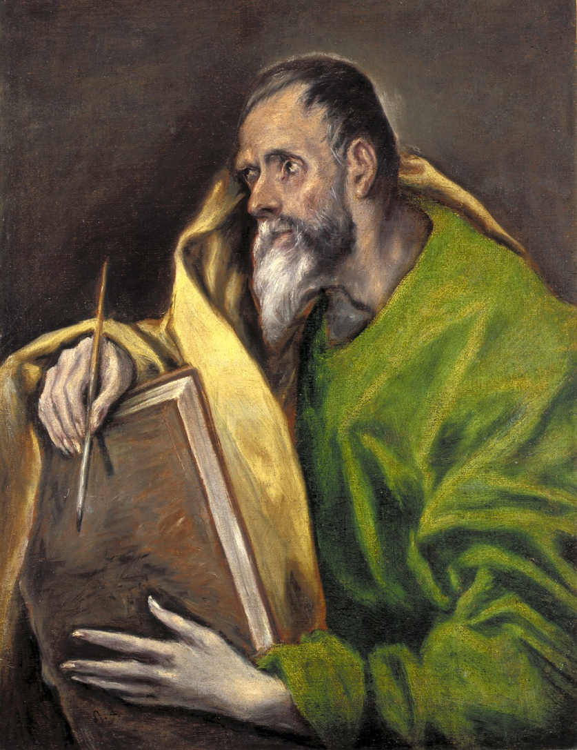
The Holy Spirit in the Gospel of Luke
Who, when, where and to whom?
The Holy Spirit in Luke 1-4
The Holy Spirit in the ministry of Jesus
The Holy Spirit and the disciples

Slide 3
In the Background
Fitzmeyer, J. The Gospel of Luke, Anchor Bible 2 Vols, Yale University Press, New Haven 2007
Johnson, Luke T., The Gospel of Luke, Sacra Pagina, Liturgical Press Minnesota 1991
Pagola , J. The Way Opened up by Jesus – Luke Convivium Press, Miami, 2013
Talbert, C.H., Reading Luke (Revised Edition) Smyth and Helwys, 2012.

Slide 4
The Gospel of Luke
What is a Gospel?
A term to explain the message of Jesus – euangelion - a Greek word meaning Good News (Mk 1:14, Acts 15:7, Rom 1:1)
Later a technical term to refer to written accounts of the life of Jesus.

Slide 5
The Gospel : a “Bios”
The ancient audience expected a bios:
To present the figure’s life and teaching as a possible model for its own living.
To legitimate or discredit important community values and practices.
To shape the identity and guide the audience’s way of life.

Slide 6
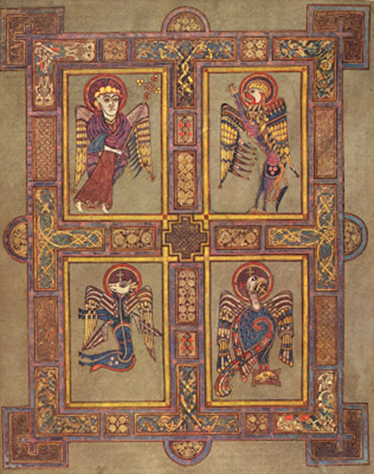
The Sources of the Gospels
Individual Memory – doubtless an influence but does not account for the texts of the gospels as we have them.
Community tradition: the link between Jesus and the Gospels is the Christian community that collected, preserved and interpreted these materials as the expression of a vibrant faith.

Slide 7

Types of material from and about Jesus
Individual stories and sayings circulated as separate units and where then combined in various ways in the process of tradition and redaction - like stringing beads!
Narrative traditions Miracle stories, Historical stories, Sayings, Parables.

Slide 8
The Emergence of a Gospel
Mark was the first to arrange the material in order to write a “Life” of Jesus – bios – an ancient biography.
He wishes to present a picture in order to persuade, exhort and encourage those who believe.
Tradition suggests Rome around 70AD as a possible location for its composition.

Slide 9
The Synoptic Gospels
Mark
Q
M L
Matthew Luke
Q is a source that Luke and Matthew used that contained sayings of Jesus not found in Mark. M and L are sources unique to each evangelist.

Slide 10
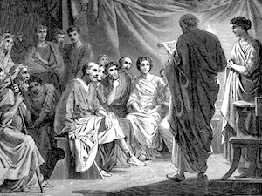
For Whom?
Largely Gentile (non-Jewish) community
(Theophilus)
Gospel focus on:
Scripture
Prayer
Poor
Mercy/Forgiveness
Supports the idea

Slide 11
By Whom?
Consensus is that Luke – Acts were written as a two volume work by the same author (both addressed to Theophilus)
Luke is referred to as a companion of Paul (Phm 24, Col 4:14 2Tim 4:11 )
The writer of Acts uses “we” in several passages suggesting that he is travelling with Paul (Acts 16:10-17)
Recent writing casts doubt on this and suggest the author is writing around 115-120, possibly in Rome.

Slide 12
Luke in the Roman World (The Priene Inscription)
“Since Providence, which has ordered all things and is deeply interested in our life, has set in most perfect order by giving us Augustus whom she filled with virtue that he might benefit humankind, sending him as a saviour (σωτhρα), both for us and for our descendants, that he might end war and arrange all things, and since he, Caesar, by his appearance (excelled even our anticipations), surpassing all previous benefactors, and not even leaving to posterity any hope of surpassing what he has done, and since the birthday of the god Augustus was the beginning of the good tidings (euaggeliwn) for the world that came by reason of him.”

Slide 13
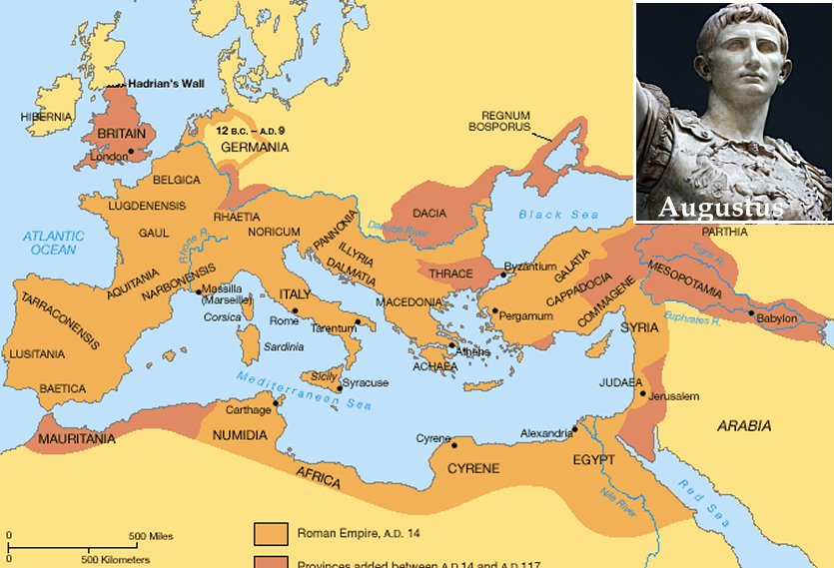

Slide 14
In the Roman World
The Imperial Propaganda of the Empire (basileia) promoted the concept of the
Pax Romana
It promised dutiful citizens
“Peace and Confidence” (eirene and asphaleia)
(see 1 Thess 5:3)

Slide 15
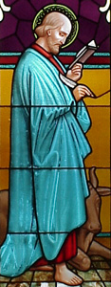
Why did Luke write?
“Since many have undertaken to set down an orderly account of the events that have been fulfilled among us,
just as they were handed on to us by those who from the beginning were eyewitnesses and servants of the word,
I too decided, after investigating everything carefully from the very first, to write an orderly account for you, most excellent Theophilus,
so that you may know the truth concerning the things about which you have been instructed.”
Luke 1:1-4

Slide 16
His “Orderly Account”
The Time of Israel
The Kingdom Promised
1:5 - 4:13 Link to OT
The Time of Jesus
The Kingdom Present
4:14 – 24:52 Ministry of Jesus
The Time of the Church
The Kingdom Proclaimed
Acts of the Apostles

Slide 17
Luke’s “Orderly Account”
Prologue 1:1 - 4
Birth Story 1:5 - 2:52
Preparation for ministry 3:1 - 4:13
- John the Baptist
- Genealogy
-Temptation
Ministry in Galilee 4:14 - 9:50
Journey to Jerusalem 9:51 -19:27
In Jerusalem 19:28 - 21:38
The Passion / Resurrection 22:1 - 24:53

Slide 18
The Role of Luke 1:5-4:13
Biographies in the ancient world frequently included a section that indicated how from the first moments it was apparent that the subject was marked out as someone special.
Suetonius and his Life of Augustus began with a series of prophecies and portents that anticipated the greatness of the future emperor.
The content of Luke 1:5 -4:15 does just that in preparing the reader to understand who Jesus is.

Slide 19
Anticipating (1)
1.Annunciation of the birth of John 1:5-25 | 2.Annunciation of the birth of Jesus 1:26-38
3.Visitation 1:39-56
4.Birth of John 1:57-80 | 5.Birth of Jesus 2:1-20
6.The Presentation in the Temple 2:22-40
7.Jesus in the Temple, aged 12 2:41-52
Notes:
In the tradition, Luke is known as a painter. What is certain is that he was a literary artist.
Notice the careful arrangement.
The stories of John the Baptist and Jesus are told in parallel.
There are two annunciations, one to Zechariah and one to Mary.
Correspondingly, there are two births.
The writer wants us to remember similar Old Testament stories of annunciations, for example, the birth of Samuel in 1Sam 1.
At the same time, Luke brings together the stories of John and Jesus, firstly to show they are connected, but secondly, to highlight the differences in role and identity.
It says of John, “He will be great in the sight of the Lord”.
Of Jesus, it says, “He will be great and will be called the Son of the Most High, and the Lord God will give him the throne of his ancestor David.”
In the following two internet web casts, we will return to scene 2, the Annunciation to Mary, and to scene 5, the Birth of Jesus.

Slide 20
Anticipating (2)
3:1-9 – John: Old Testament Prophet
3:10-14 – Prophetic preaching
3:15-17 – Prophetic anticipation
3:18-20 – The Fate of the Prophet
3:21-22 - Jesus baptized (after all the people)
3:23-38 – Jesus Son of God is also son of Adam
4:1-13 – Jesus is Tested in the Wilderness

Slide 21

The Holy Spirit in Luke 1:5-4:13
Holy Spirit 17x in Luke - 54x in Acts
11x in 1:5-4:13
1:15, 35, 41, 67 Annunciation stories foretell presence of the Spirit in John and Jesus. Characters are “filled with the Holy Spirit” Zechariah and Elizabeth
2:25, 26, 27 Simeon: Spirit rests on him, reveals to him and guides him

Slide 22

The Holy Spirit in Luke 1:5-4:13 (2)
3:16, 22 “Jesus will baptise with the Holy Spirit and fire.” “…The Holy Spirit descended upon him in bodily form like a dove…” (Anticipates Pentecost)
4:1,2 Jesus, full of the Holy Spirit, was led by the Spirit in the desert. (Recalls Deuteronomy)
Activity of the Spirit is consistent with OT understanding of the role of God’s Spirit.

Slide 23
The Testing and Jesus’ Response
The focus of the testing is not on whether Jesus is the Son of God but how he is to be that!
“Since you are the Son of God…”
He rejects the abuse of the miraculous (Dt 8;3)
He rejects the abuse of power (Dt 6:13)
He rejects the distortion of faith (Ps 91:11, Dt 6:16)
These are all pointers to the meaning of the “REIGN OF GOD”

Slide 24
The Holy Spirit in the Ministry of Jesus
7x in Luke 4:14-24:49*
4:14,18 Power and Presence
10:21 Rejoicing in….
11:13 Gift in prayer
12:10,12 The sin against and teaching presence of…
24:49* Clothed with power from on high

Slide 25
Something to think about!!
Choose one thing from the Gospels that Jesus said or did that that sums up for you the core meaning of Christianity!

Slide 26
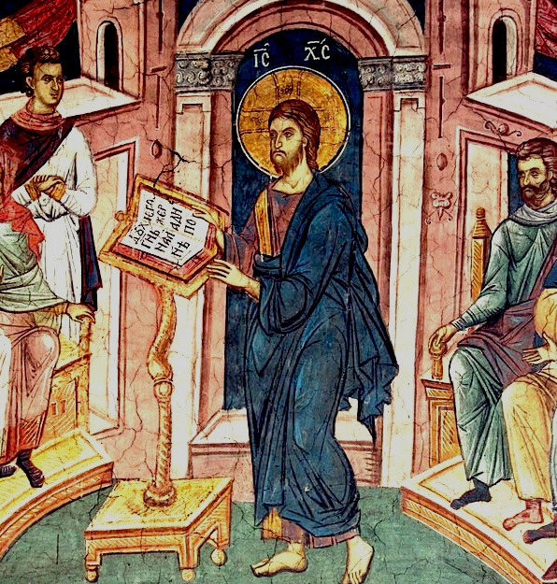
Nazareth
“Jesus, filled with the power of the Spirit returned to Galilee…”
To be understood in the light of 1:35, 3:21-22 and 4:1.
Power (dunamis) see 4:36, 5:17, 6:19, 8:46, 10:19, 24:49

Slide 27
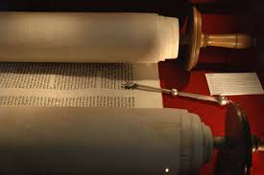
Beginning of the Ministry
“The Spirit of the Lord is upon me because he has anointed me to bring good news to the poor. He has sent me to proclaim release to the captives and recovery of sight to the blind, to let the oppressed go free, to proclaim the year of the Lord’s favour.”
“Today this Scripture has been fulfilled in your hearing”
(Lk 4:16-21)

Slide 28
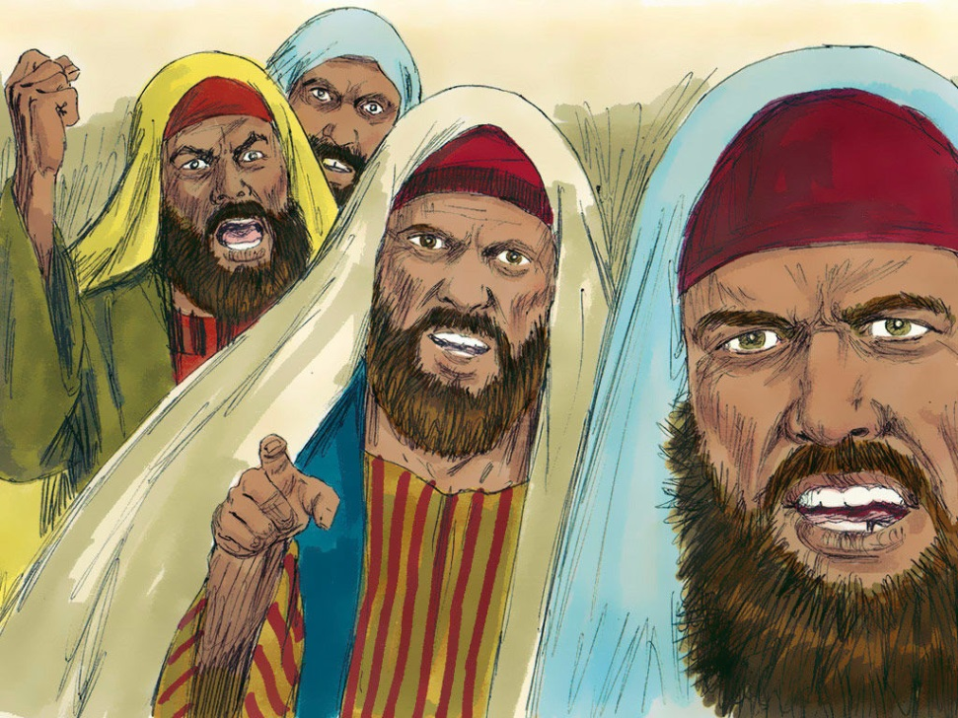
Key to Understanding the Spirit’s Role
In Jesus, through the power of the Holy Spirit all that the people of God longed for is now present.
It is nothing less than the Compassion of God
This is the meaning of the REIGN OF GOD…

Slide 29
Compassion Shared and Demanded (The Reign of God)
“They had come to hear him and to be healed of their diseases; and those who were troubled with unclean spirits were cured. And all in the crowd were trying to touch him for power came out of him and healed them all.” 6:18-19
“Be compassionate just as your Father is compassionate. Do not judge and I will not be judged. Do not condemn and you will not be condemned. Forgive and you will be forgiven. Give and gifts will be given you; a good measure packed together shaken down and overflowing, will be poured into your lap. The measure you use will be the measure used for you. ”
6:36-38

Slide 30
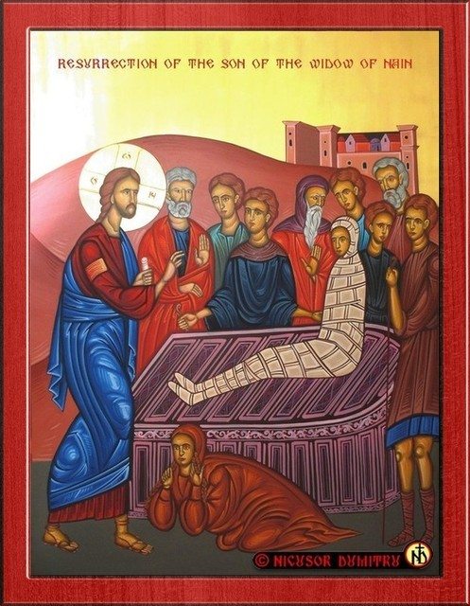
Widow of Naim 7:11-17
“And seeing her the Lord had compassion for her and he said to her ‘do not weep’…
“They glorified God saying, ‘A great prophet has arisen among us and God has visited his people!”

Slide 31
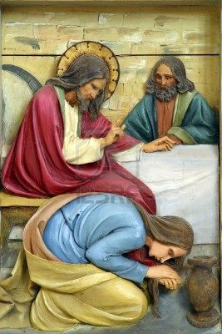
Luke 7:18 -50
Contrasting responses to the presence of the reign of God through gift of forgiveness
Context : John’s question and the possibility of “scandal”.
Pharisee’s response (cf 6:37)
v’s
Woman’s response (Cf 1:78)

Slide 32
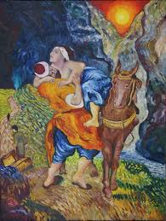
The Good Samaritan Another Lesson on Compassion
Context - disciples share in mission to spread the reign of God (10:1-20)
Jesus rejoices in the Holy Spirit that this is the time.
Theology question answered with a story on compassion.
“Go and do likewise.”

Slide 33
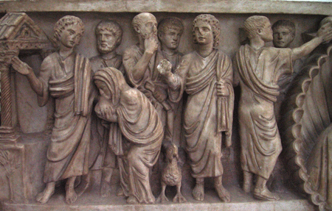
Woman in the Synagogue 13:10-17
Context – Teaching on repentance
Excluded woman healed and praise is the response to the experience of compassion… but only from some!
Followed by seed and yeast parables!

Slide 34
The Parables of Mercy…Luke 15
Context: Grumbling because… “This fellow welcomes sinners and eats with them.”
Lost sheep … found and joy follows
Lost coin… found and joy follows (as in heaven
Lost son …. found and joy follows or does it?
“While he was still far off his father saw him and was filled with compassion…” (15:20)
(splangnizomai, splangna 7:13, 10:33)

Slide 35
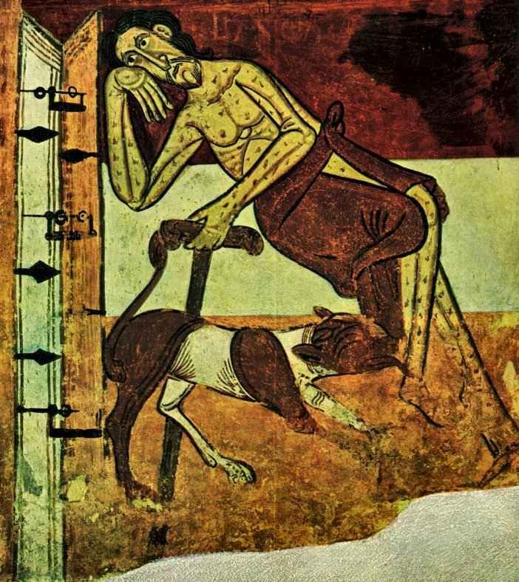
Dives and Lazarus
Lk 16:19-31
A prophetic critique of the abandonment of the poor; very much from within the Jewish tradition of care for the oppressed.
The one who showed no compassion seeks it.

Slide 36
Jesus on The Holy Spirit – The Paradox
12:1-12 Urgent Exhortations
1-3 Avoid Hypocrisy!
4-7 The Transcendent Perspective Be afraid but don’t be afraid!!
8-9 Courageous Witness
10-12 The Holy Spirit will teach you
22-34 Prioritise the Reign of God! (17:21)

Slide 37
Resurrection and Holy Spirit
God’s faithfulness is demonstrated in the Passion/Resurrection
– Emmaus account (24:26-27, 45-49)
The Disciples are to witness to these things
The Spirit is the consistent thread that is woven throughout the narrative demonstrating that it is all God’s work.

Slide 38
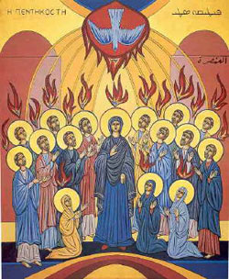
The Acts of the Apostles
INTRODUCTION Acts 1:1-2:47 Transition from the time of Jesus to the time of the Church: Pentecost and the Gift of the Spirit. Narrative rooted in Jewish tradition and symbolism.

Slide 39
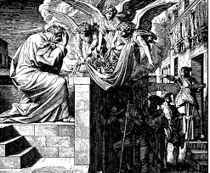
Structure of Acts
Part I Acts 3:1-15:35 Preparation 3:1-9:43 Climatic Event 10:1-11:18 Denouement 11:19-15:35
Part II Acts 15:36 – 28:31 Preparation 15:36-25:37 Climactic Event 26:1-32 Denouement 27:1-28:31

Slide 40
The Holy Spirit in Acts
Pentecost Jewish festival 50 days after Passover Recalling the Gift of the Torah and the Covenant on Mt Sinai (Exodus 24)
Luke uses this backdrop to reflect the Easter experience of the early Church: compare Matt 28:20 / Jn 20:21-22

Slide 41

Key Texts
Acts 1:2,5,8,16 Transition
Acts 2:4,33,38 Pentecost
Acts 4:8.25,31 Persecution
Acts 8:17 God’s Spirit
Acts 10: 38,44,45,47 Given to the Gentiles Acts 11:15-16 (Repeated!!)

Slide 42
In Luke – Acts
The Holy Spirit is the Spirit of God as spoken about, experienced and promised in the OT.
The Spirit is the power of God effective in the world to bring about the transformation that is the Reign of God
It is present in the Church and in the Word guiding and directing the community
It is not the Church’s gift to give!

Slide 43
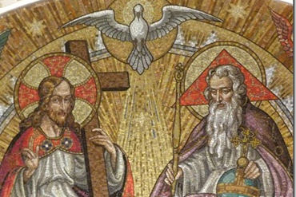
In John
Jn 1:32-33 – Remains on Jesus
Jn 7:37 – Flows from the believer’s heart
Jn 14:16 – Consoler / Advocate
Jn 14:25 – Advocate /Teacher/ Source of Peace
Jn 16:7-15 – Advocate /Spirit of Truth
Jn 20:21-22 – Easter Gift

